Slide 1
HOSPITAL DASHBOARD
Key Findings, Areas for Improvement & Recommendations
1,000-Patient Analysis • Length of Stay • Treatment Cost • Readmissions
Internship Project

Slide 2
Introduction
The hospital dashboard provides an overview of 1,000 patients — covering departmental distribution, diagnoses, length of stay, treatment cost, and readmission patterns. Overall, the data shows a hospital managing substantial patient volume, with clear opportunities to improve outcomes, reduce avoidable readmissions, and strengthen departmental performance.
1,000
7.46
₦330.28K
21%
Total Patients
Avg. Length of Stay (days)
Avg. Treatment Cost
Overall Readmission Rate
These indicators suggest opportunities to reduce avoidable readmissions and optimize resource utilization across departments.
2

Slide 3
Key Findings
1 — Patient Volume by Department
What the data shows
Emergency leads with 192 patients
Followed by Surgery (153) and Cardiology (137)
High Emergency volume signals demand pressure on staff, beds and resources
Oncology and ICU carry the lowest volume, but (as shown next) not the lowest risk
3

Slide 4
Key Findings
2 — Readmissions Are a Significant Concern
Roughly 1 in 5 patients (21%) was readmitted overall. Readmissions concentrate in a few departments and among older patients — the two groups management should prioritize first.
Highest Readmission Rates by Department
Age Group Requiring Greater Follow-Up
Cardiology
~28%
38%
Oncology
~25%
Readmission rate for patients aged 61+ — substantially higher than every other age group
ICU
~24%
Hospital Overall
21%
Older patients likely need more intensive discharge planning, medication monitoring, and post-discharge support.
4

Slide 5
Key Findings
3 — Disease Burden, Stay & Cost
Disease Burden Is Concentrated
7.46 days
Significant patient volumes are tied to a small set of recurring diagnoses — key targets for preventive care and patient education.
Average Length of Stay
Malaria
Substantial resource utilization worth investigating for delays in procedures, bed availability, or discharge processes.
Diabetes
COVID-19
Kidney Disease
₦330.28K
Fractures
Average Treatment Cost
Management should track cost drivers by department, diagnosis, and patient group.
5

Slide 6
Key Findings
4 — Which Month Has the Highest Readmission Rate?
September
Highest readmission rate of the year, at approximately 29–30%.
Secondary peaks
October (~26%), December (~25.5%) and January (~25%) also run high — all just after or during holiday / year-end admission surges.
Implication: discharge follow-up staffing should scale up ahead of Sept, Oct, Dec and Jan.
6

Slide 7
Key Findings
5 — Do Shorter Stays Result in More Readmissions?
53.33%
of readmitted patients had a SHORTER stay (1–6 days) on their prior admission, vs. 46.67% for longer stays (7–14 days).
What this suggests
Yes — a modest but real association: shorter stays carry a slightly higher share of readmissions than longer stays. This points to possible early discharge before patients are clinically ready, warranting review of discharge-readiness criteria and post-discharge care rather than assuming shorter stays are simply ‘more efficient.’
7

Slide 8
Key Findings
6 — Are Higher Costs Linked to Better Outcomes?
No. The costliest outcome on average is Deceased — not Recovered.
Deceased
Highest avg. cost
Management question
Spend is being driven by case severity and complications,but is not translating into better survival or recovery. This raises a real question about treatment efficiency and resource utilization.
Improved
₦334.48K
Recovered
₦332.30K
Referred
₦285.29K
Cost should be reviewed alongside clinical complexity — not treated as a proxy for quality of care.
“Higher treatment costs were not consistently associated with better patient outcomes. The deceased patient group recorded the highest average treatment cost, indicating that increased expenditure does not necessarily translate into improved patient outcomes.”
8

Slide 9
Key Findings
7 — High Cost, Poor Outcome Departments
Outcomes were grouped as Good (Recovered + Improved) vs. Poor (Referred + Deceased). Filtering the dashboard to Poor Outcome patients only, and re-reading Treatment Cost by Department against that filter:
🟢 Good: Recovered + Improved
🔴 Poor: Referred + Deceased
Finding
Surgery, Oncology and Orthopedics are the key high-cost departments among poor-outcome patients — Surgery (₦6M), Oncology (₦4M) and Orthopedics (₦4M).
Management implication
These departments should be prioritized for clinical outcome review and cost-efficiency analysis to determine why relatively high expenditure is still associated with poor patient outcomes.
Recommendation: conduct department-level reviews of treatment protocols, length of stay, resource utilization, and discharge planning in Surgery, Oncology, and Orthopedics — with priority given to Surgery due to its highest poor-outcome treatment cost.
9

Slide 10
Priority Areas
Departments Needing Improvement
Patient Groups Requiring Follow-Up
1
Cardiology
Patients aged 61+
Highest overall readmission rate (~28%)
Primary follow-up target — 38% readmission rate
2
Oncology
Diabetes patients
High readmission (~25%) and high cost among poor-outcome patients (₦4M)
Chronic condition requiring structured monitoring
3
Surgery
Kidney Disease patients
Highest treatment cost among poor-outcome patients (₦6M)
Chronic condition requiring structured monitoring
4
Orthopedics
Malaria patients
High cost among poor-outcome patients (₦4M)
Elevated risk of repeat admission
10

Slide 11
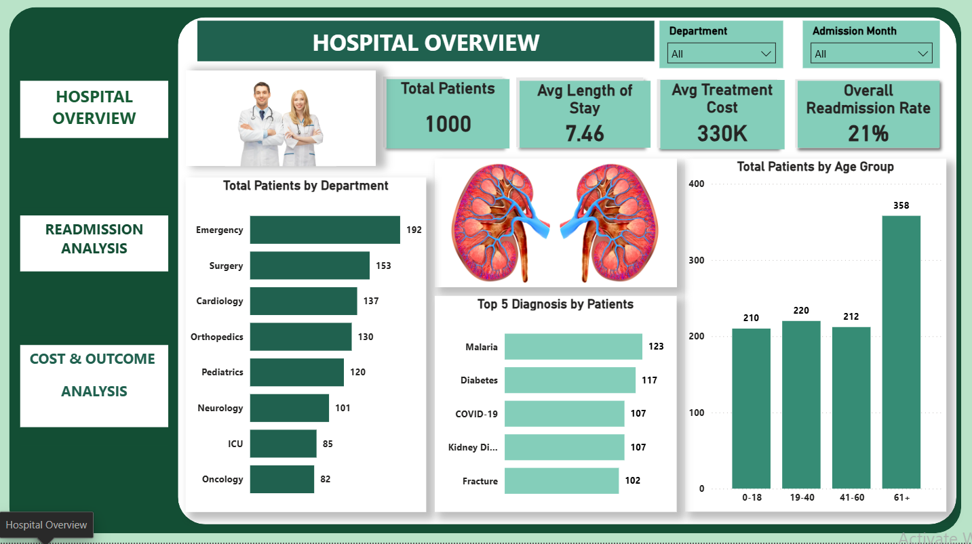

Slide 12
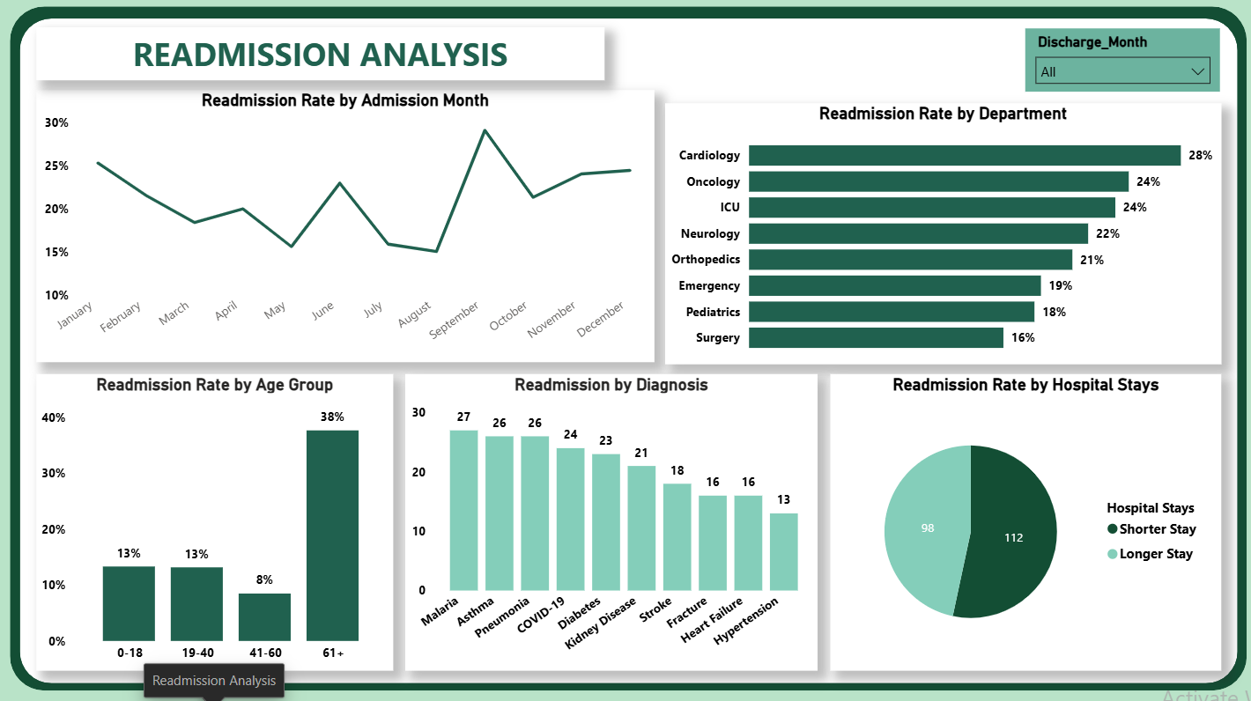
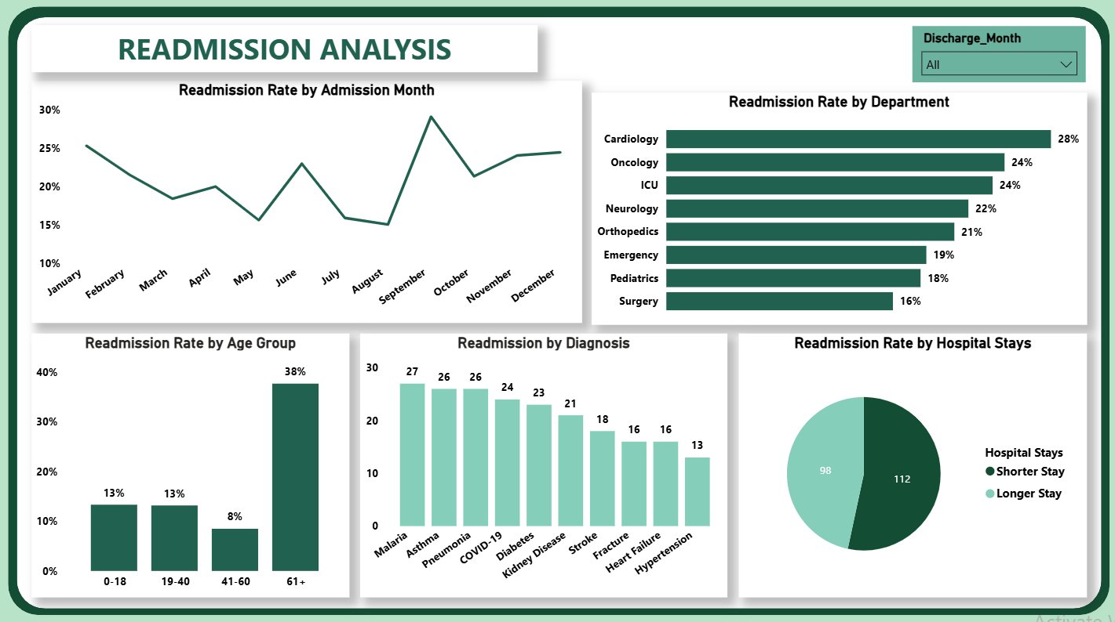

Slide 13
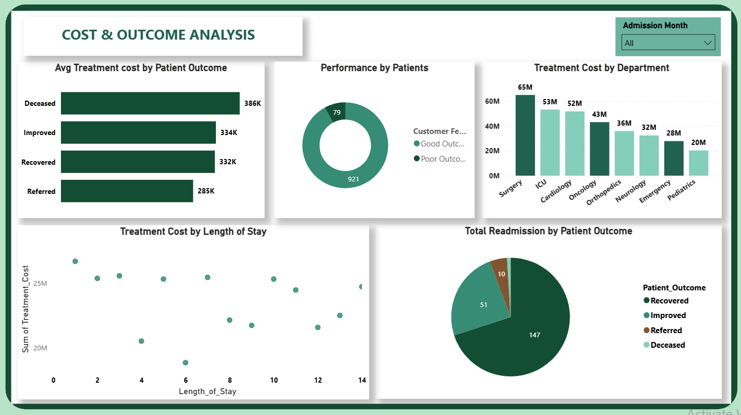

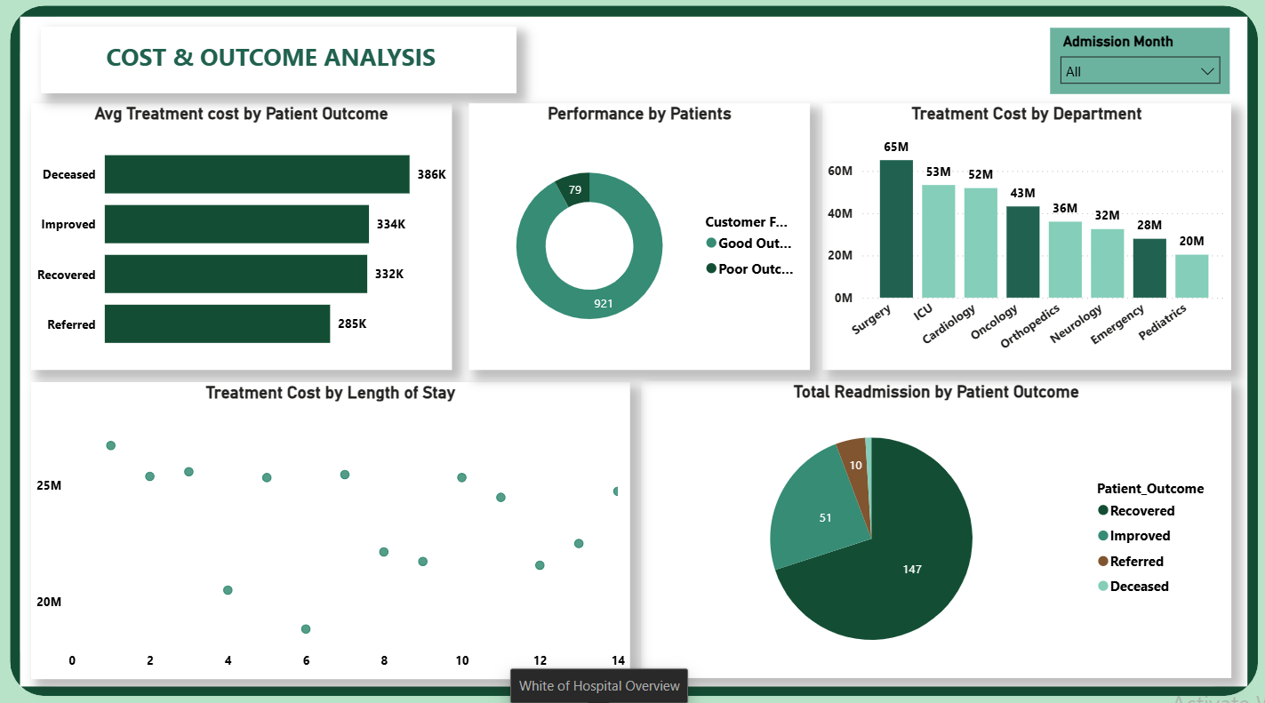

Slide 14
Recommendations
Data-driven actions, mapped to each finding
1
FINDING: CARDIOLOGY / ONCOLOGY READMISSIONS
5
FINDING: COST VS. OUTCOME (DECEASED HIGHEST COST)
Conduct root-cause readmission reviews starting with Cardiology (~28%) and Oncology (~25%).
Audit high-cost, high-mortality cases to separate unavoidable complexity from avoidable cost drivers.
2
FINDING: SEPTEMBER / SEASONAL PEAKS
6
FINDING: SURGERY, ONCOLOGY & ORTHOPEDICS
Scale up discharge-planning staff and post-discharge outreach ahead of Sept, Oct, Dec and Jan peaks.
Review treatment protocols, LOS, resource use & discharge planning in these poor-outcome, high-cost departments — Surgery first.
3
FINDING: SHORTER STAYS & READMISSION
7
FINDING: DISEASE BURDEN
Review discharge-readiness criteria for 1–6 day stays; add mandatory 48–72hr follow-up contact.
Build preventive-care and patient-education programs for Malaria, Diabetes, COVID-19, Kidney Disease and Fractures.
4
FINDING: PATIENTS AGED 61+
8
FINDING: OVERALL MONITORING
Launch structured post-discharge care for 61+: medication review, follow-up scheduling, home-care support.
Establish a monthly KPI dashboard: readmission by month/department/age/LOS, plus cost-to-outcome ratio.
11

Slide 15
Conclusion
The data points to five clear priorities: reducing readmissions (esp. Cardiology, September peaks and early-discharge risk), improving outcomes for patients 61+, fixing the cost-outcome mismatch in Surgery, Oncology & Orthopedics, and tightening resource utilization overall.
1
2
3
4
Reduce avoidable readmissions — Cardiology & Oncology, and around Sept/Oct/Dec/Jan peaks
Improve outcomes for patients 61+ (38% readmission) and review early-discharge risk (1–6 day stays)
Fix the cost-outcome mismatch in Surgery, Oncology & Orthopedics
Treat cost as a signal to investigate, not a proxy for quality — track cost-to-outcome monthly
By focusing interventions on the patient groups, months, and departments identified through the data, management can improve quality of care while reducing unnecessary hospital utilization and cost.

